Slide 1


Design patterns
Speaker: Dovgan
Name Volodimir

Slide 2
Agenda
What is design pattern
Patterns classification
Creational design patterns
Structural patterns
Behavioral patterns
Patterns details
Conclusions

Slide 3

What is design pattern
Design patterns can speed up the development process by providing tested, proven development paradigms.
Reusing design patterns helps to prevent subtle issues that can cause major problems and improves code readability for coders and architects familiar with the patterns.
Design patterns provide general solutions, documented in a format that doesn't require specifics tied to a particular problem.
In addition, patterns allow developers to communicate using well-known, well understood names for software interactions.
Common design patterns can be improved over time, making them more robust than ad-hoc designs.

Slide 4
Patterns classification
Creational design patterns - these design patterns are all about class instantiation. This pattern can be further divided into class-creation patterns and object-creational patterns. While class-creation patterns use inheritance effectively in the instantiation process, object-creation patterns use delegation effectively to get the job done.
Structural design patterns - these design patterns are all about Class and Object composition. Structural class-creation patterns use inheritance to compose interfaces. Structural object-patterns define ways to compose objects to obtain new functionality.
Behavioral design patterns - these design patterns are all about Class's objects communication. Behavioral patterns are those patterns that are most specifically concerned with communication between objects.

Slide 5
Creational design patterns
Abstract factory - creates an instance of several families of classes.
Builder - separates object construction from its representation.
Factory method - creates an instance of several derived classes.
Object pool - avoid expensive acquisition and release of resources by recycling objects that are no longer in use.
Prototype - a fully initialized instance to be copied or cloned.
Singleton - a class of which only a single instance can exist

Slide 6
Structural design patterns
Adapter - match interfaces of different classes.
Bridge - separates object interface from its implementation.
Composite - a tree structure of simple and composite objects.
Decorator - add responsibilities to objects dynamically.
Facade- a single class that represents an entire subsystem.
Flyweight - a fine-grained instance used for efficient sharing
Proxy - an object representing another object

Slide 7
Behavioral design patterns
Chain of responsibility - a way of passing a request between a chain of objects.
Command - encapsulate a command request as an object.
Iterator- sequentially access the elements of a collection.
Mediator- defines simplified communication between classes.
Observer - a way of notifying change to a number of classes
Strategy- encapsulates an algorithm inside a class
Template method - defer the exact steps of an algorithm to a subclass
Visitor - Defines a new operation to a class without change

Slide 8
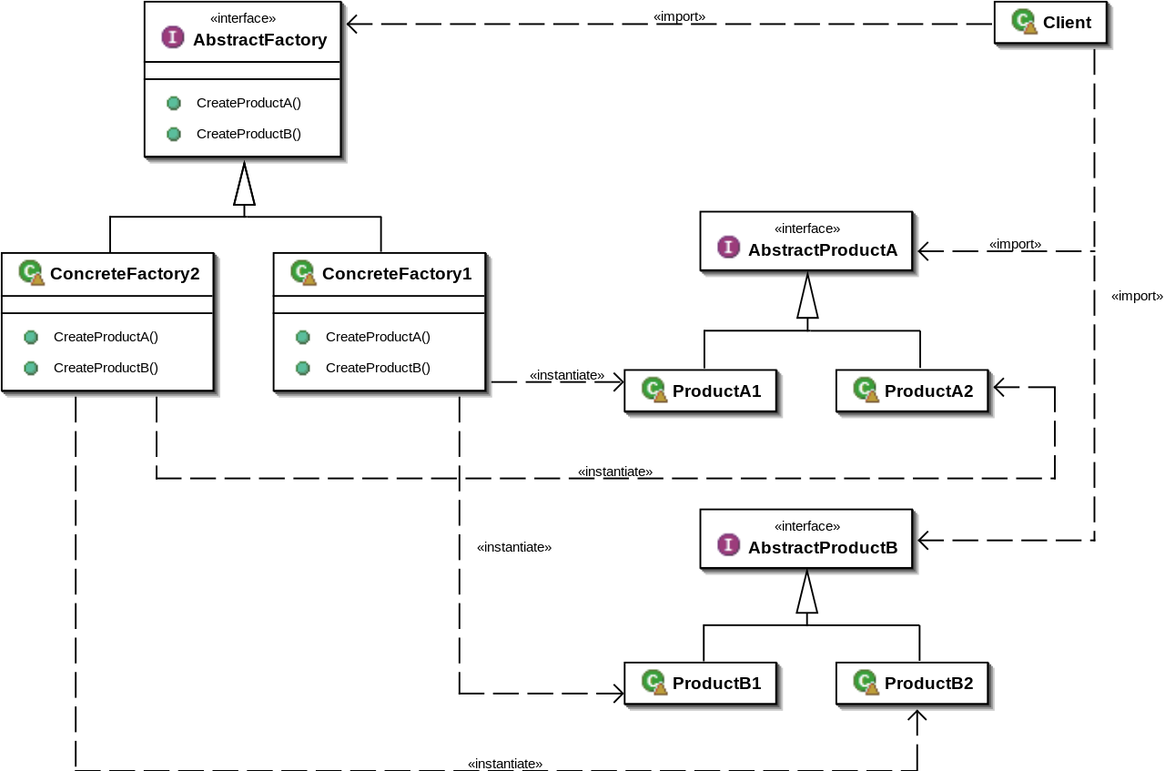
Abstract factory pattern

Slide 9
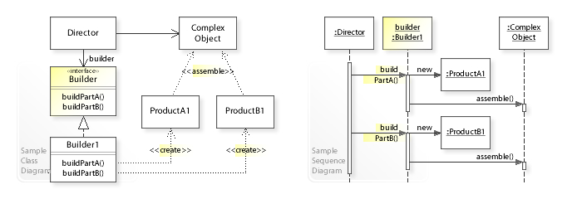
Builder pattern

Slide 10
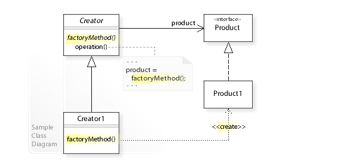
Factory method pattern

Slide 11
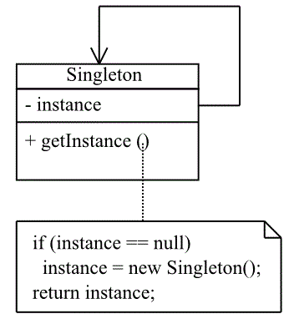
Singleton pattern

Slide 12
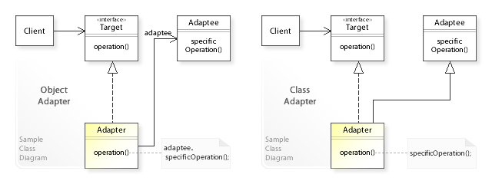
Adapter pattern

Slide 13
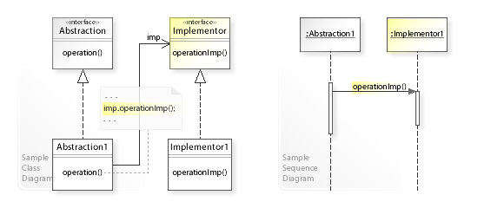
Bridge pattern

Slide 14
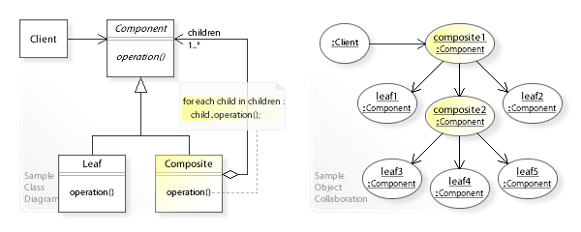
Composite pattern

Slide 15
Composite pattern

Slide 16
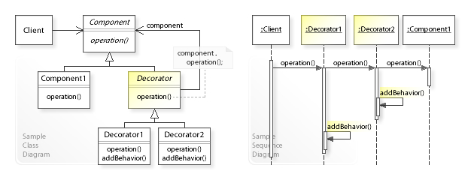
Decorator pattern

Slide 17
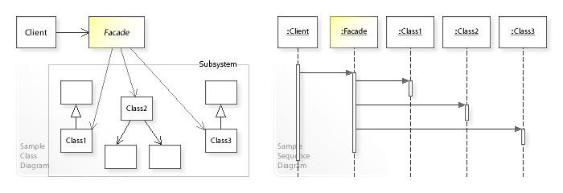
Facade pattern

Slide 18
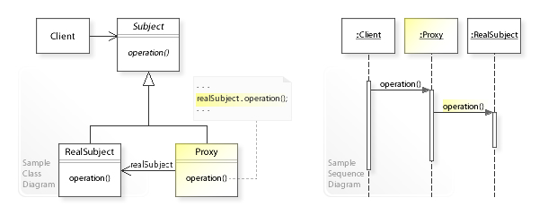
Proxy pattern

Slide 19
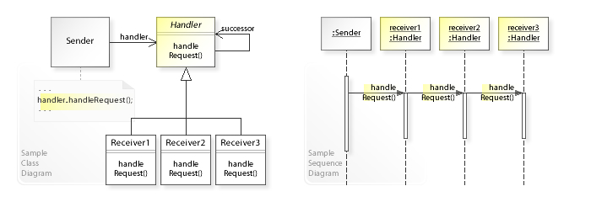
Chain of responsibility pattern

Slide 20
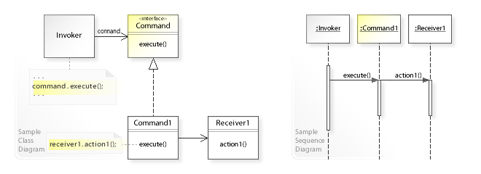
Command pattern

Slide 21
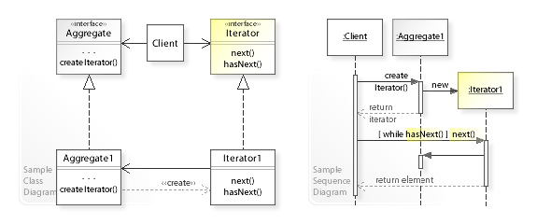
Iterator pattern

Slide 22
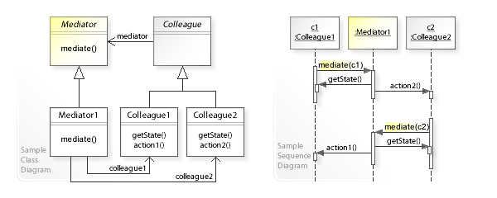
Meditator pattern

Slide 23
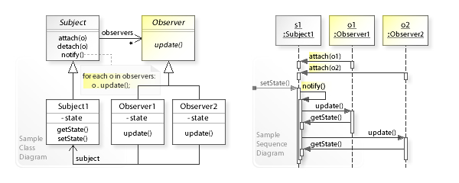
Observer pattern

Slide 24
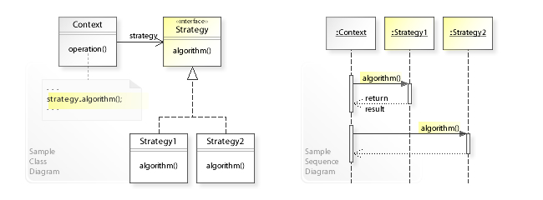
Strategy pattern

Slide 25
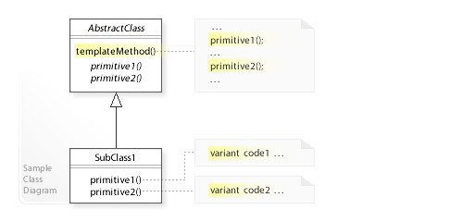
Template method pattern

Slide 26
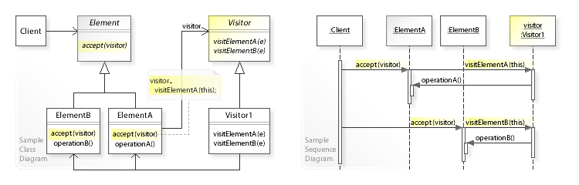
Visitor pattern

Slide 27

Conclusions
Design patterns make it easy for us to build on the shoulders of developers who have defined solutions to challenging problems and architectures over a number of decades. The contents of this presentation should hopefully provide sufficient information to get started using the patterns we covered .
It's important for us to be aware of these patterns but it's also essential to know how and when to use them. Study the pros and cons of each pattern before employing them. Take the time out to experiment with patterns to fully appreciate what they offer and make usage judgements based on a pattern's true value to your application.

Slide 28

Thank you!

